Slide 1

DIPARTIMENTO DI INGEGNERIA ELETTRICA E TECNOLOGIE DELL’INFORMAZIONE
SCUOLA POLITECNICA E DELLE SCIENZE DI BASE
LAUREA MAGISTRALE IN INGEGNERIA DELL’AUTOMAZIONE E ROBOTICA
Trajectory Tracking for Quadrotors under External Wrenches: Hierarchical vs Passivity-Based Control
Candidates: Matteo Russo, Federico Trenti
Supervisor: Prof. Fabio Ruggiero
Trajectory Tracking for Quadrotors under External Wrenches: Hierarchical vs Passivity-Based Control

Slide 2

Summary
Quadrotor model
Quadrotor model for Hierarchical Control
Quadrotor model for Passivity-Based Control
Trajectory Planning
Hierarchical Control
Passivity-based Control
Simulation Results
Results without disturbance
Results with disturbance
Conclusions
Posture Control
Orientation Control
Outer Loop
Inner Loop
External Wrench Estimation
Trajectory Tracking for Quadrotors under External Wrenches: Hierarchical vs Passivity-Based Control

Slide 3
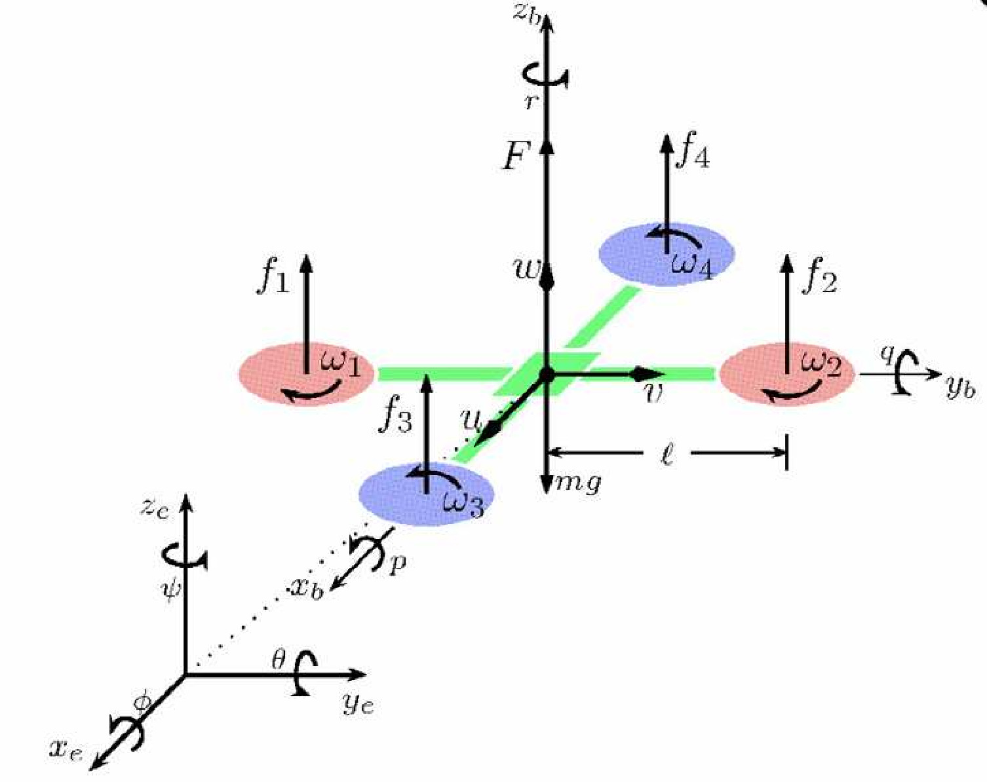
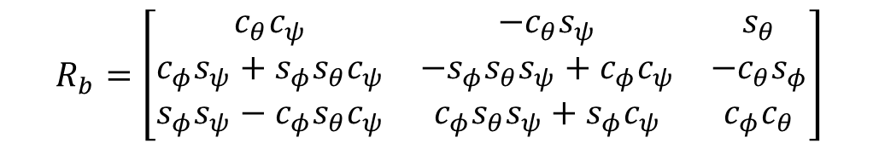
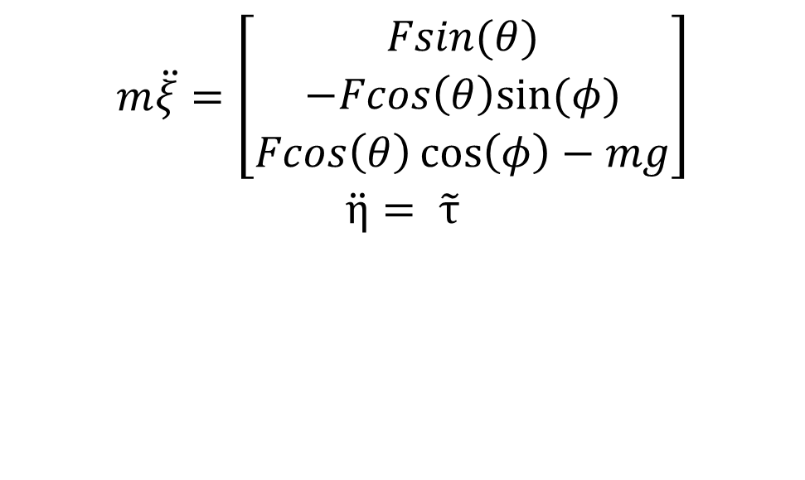
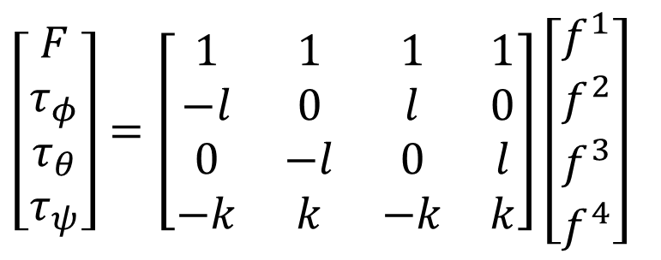
Quadrotor Model for Hierarchical Control
$$m\ddot{ξ}=\left[\begin{aligned}Fsin(θ) \\ −Fcos\left(θ\right)sin⁡(φ) \\ Fcos\left(θ\right)\cos\left(φ\right)−mg\end{aligned}\right]$$
$$\ddot{η}= \tilde{τ}$$
$\left[\begin{matrix}F \\ τ_{φ} \\ τ_{θ} \\ τ_{ψ}\end{matrix}\right]=\left[\begin{matrix}1 & 1 & 1 & 1 \\ −l & 0 & l & 0 \\ 0 & −l & 0 & l \\ −k & k & −k & k\end{matrix}\right]$ $\left[\begin{matrix}f^{1} \\ f^{2} \\ f^{3} \\ f^{4}\end{matrix}\right]$
$$R_{b}=\left[\begin{matrix}c_{θ}c_{ψ} & −c_{θ}s_{ψ} & s_{θ} \\ c_{φ}s_{ψ}+s_{φ}s_{θ}c_{ψ} & {−s}_{φ}s_{θ}s_{ψ}+c_{φ}c_{ψ} & −c_{θ}s_{φ} \\ s_{φ}s_{ψ}−c_{φ}s_{θ}c_{ψ} & c_{φ}s_{θ}s_{ψ}+s_{φ}c_{ψ} & c_{φ}c_{θ}\end{matrix}\right]$$
Trajectory Tracking for Quadrotors under External Wrenches: Hierarchical vs Passivity-Based Control

Slide 4


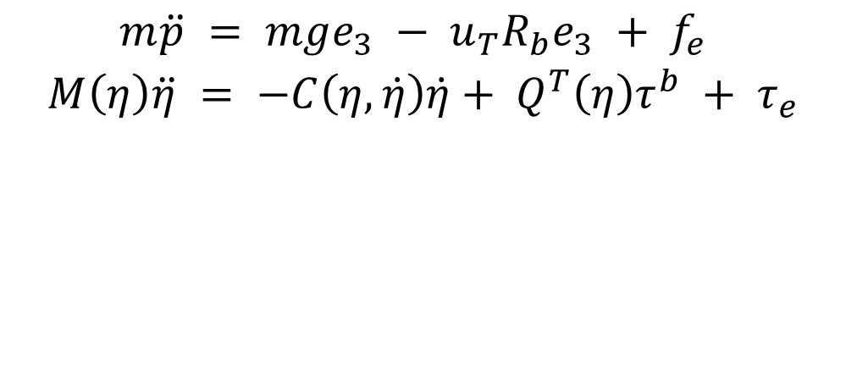
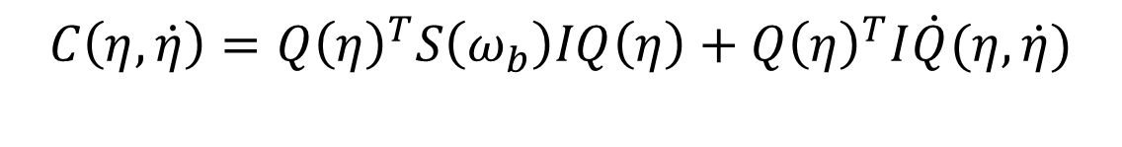
Quadrotor model for Passivity-Based Control
$$m\ddot{p} = mge_{3} − u_{T}R_{b}e_{3} + {f_{e} }_{ }$$
$$M\left(η\right)\ddot{η} = −C\left(η, \dot{η}\right)\dot{η}+ Q^{T}\left(η\right)τ^{b} + τ_{e}^{ }$$
$$Q=\left[\begin{matrix}1 & 0 & −s_{θ} \\ 0 & c_{φ} & c_{θ}s_{φ} \\ 0 & {−s}_{φ} & c_{θ}c_{φ}\end{matrix}\right]$$
$$C\left(η, \dot{η}\right)=Q{\left(η\right)}^{T}S\left(ω_{b}\right)IQ\left(η\right)+Q{\left(η\right)}^{T}I\dot{Q}(η,\dot{η})$$
$$M\left(η\right)=Q{\left(η\right)}^{T}IQ(η)$$
Trajectory Tracking for Quadrotors under External Wrenches: Hierarchical vs Passivity-Based Control

Slide 5
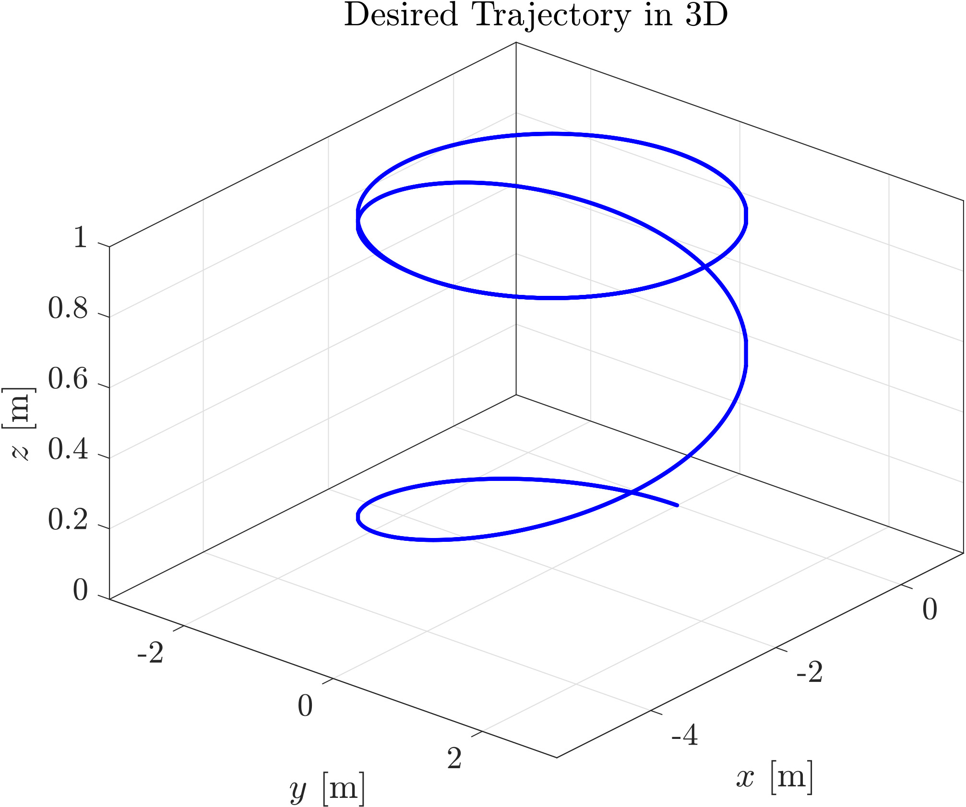
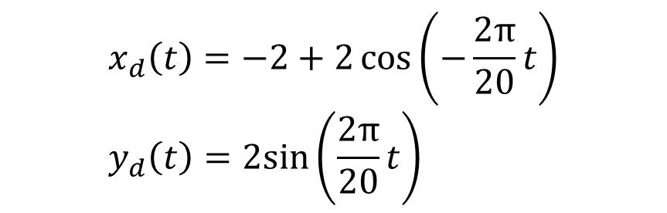
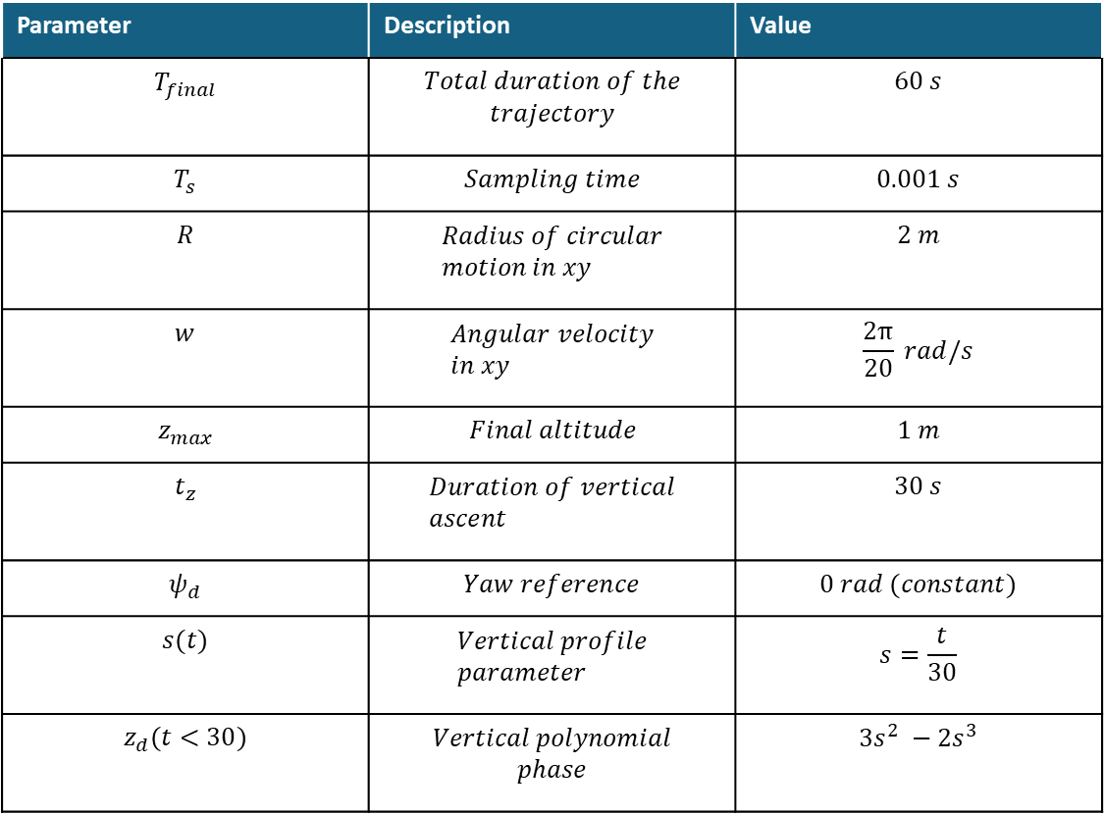
Trajectory planning
Parameter | Description | Value
$$T_{final}$$ | $$Total duration of the$$ $$trajectory$$ | $$60 s$$
$$T_{s}$$ | $$Sampling time$$ | $$0.001 s$$
$$R$$ | $$Radius of circular \\ motion in xy$$ | $$2 m$$
$$w$$ | $$Angular velocity \\ in xy$$ | $$\frac{2π}{20} rad/s$$
$$z_{max}$$ | $$Final altitude$$ | $$1 m$$
$$t_{z}$$ | $$Duration of vertical \\ ascent$$ | $$30 s$$
$$ψ_{d}$$ | $$Yaw reference$$ | $$0 rad (constant)$$
$$s(t)$$ | $$Vertical profile \\ parameter$$ | $$s=\frac{t}{30}$$
$$z_{d}(t<30)$$ | $$Vertical polynomial \\ phase$$ | $$3s^{2} −2s^{3}$$
$$x_{d}\left(t\right)=−2+2\cos\left(−\frac{2π}{20}t\right) \\ y_{d}\left(t\right)=2sin⁡\left(\frac{2π}{20}t\right)$$
Trajectory Tracking for Quadrotors under External Wrenches: Hierarchical vs Passivity-Based Control

Slide 6

Hierarchical Control
Trajectory Tracking for Quadrotors under External Wrenches: Hierarchical vs Passivity-Based Control

Slide 7
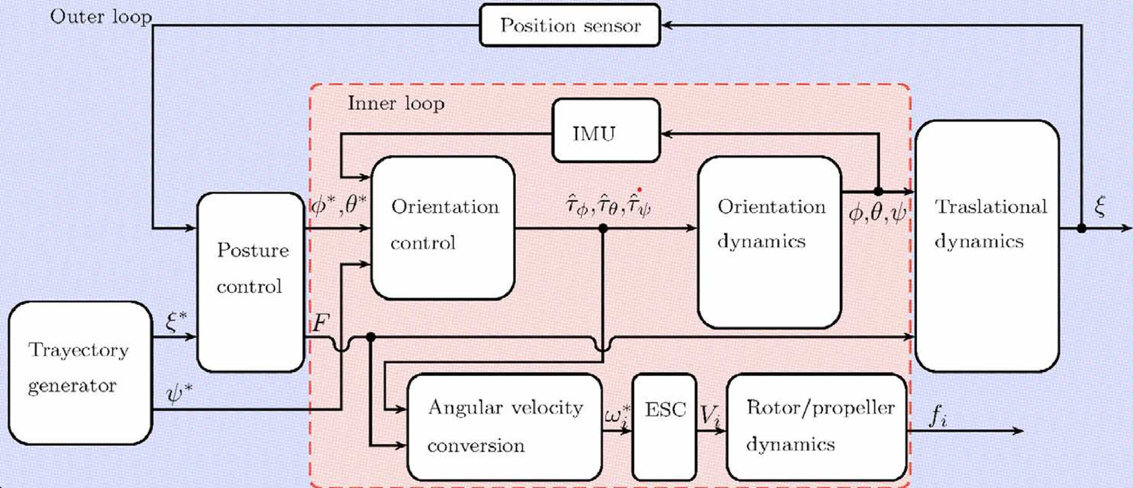
Block diagram
Trajectory Tracking for Quadrotors under External Wrenches: Hierarchical vs Passivity-Based Control

Slide 8
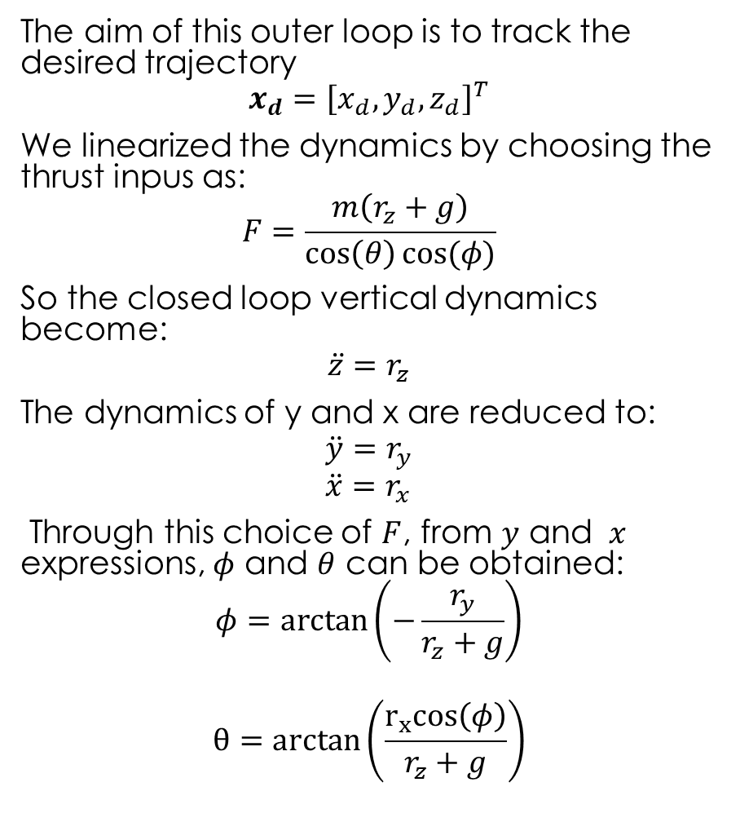
Posture Control
The aim of this outer loop is to track the desired trajectory
$$x_{d}={\left[x_{d}, y_{d}, z_{d}\right]}^{T}$$
We linearized the dynamics by choosing the thrust inpus as:
$$F=\frac{m\left(r_{z}+g\right)}{\cos\left(θ\right)cos⁡(φ)}$$
So the closed loop vertical dynamics become:
$$\ddot{z}=r_{z}$$
The dynamics of y and x are reduced to:
$$\ddot{y}=r_{y} \\ \ddot{x}=r_{x}$$
Through this choice of $F$, from $y$ and $x$ expressions, $φ$ and $θ$ can be obtained:
$$φ=\arctan\left(−\frac{r_{y}}{r_{z}+g}\right)$$
$$θ=arctan\left(\frac{r_{x}cos\left(φ\right)}{r_{z}+g}\right)$$
Trajectory Tracking for Quadrotors under External Wrenches: Hierarchical vs Passivity-Based Control

Slide 9
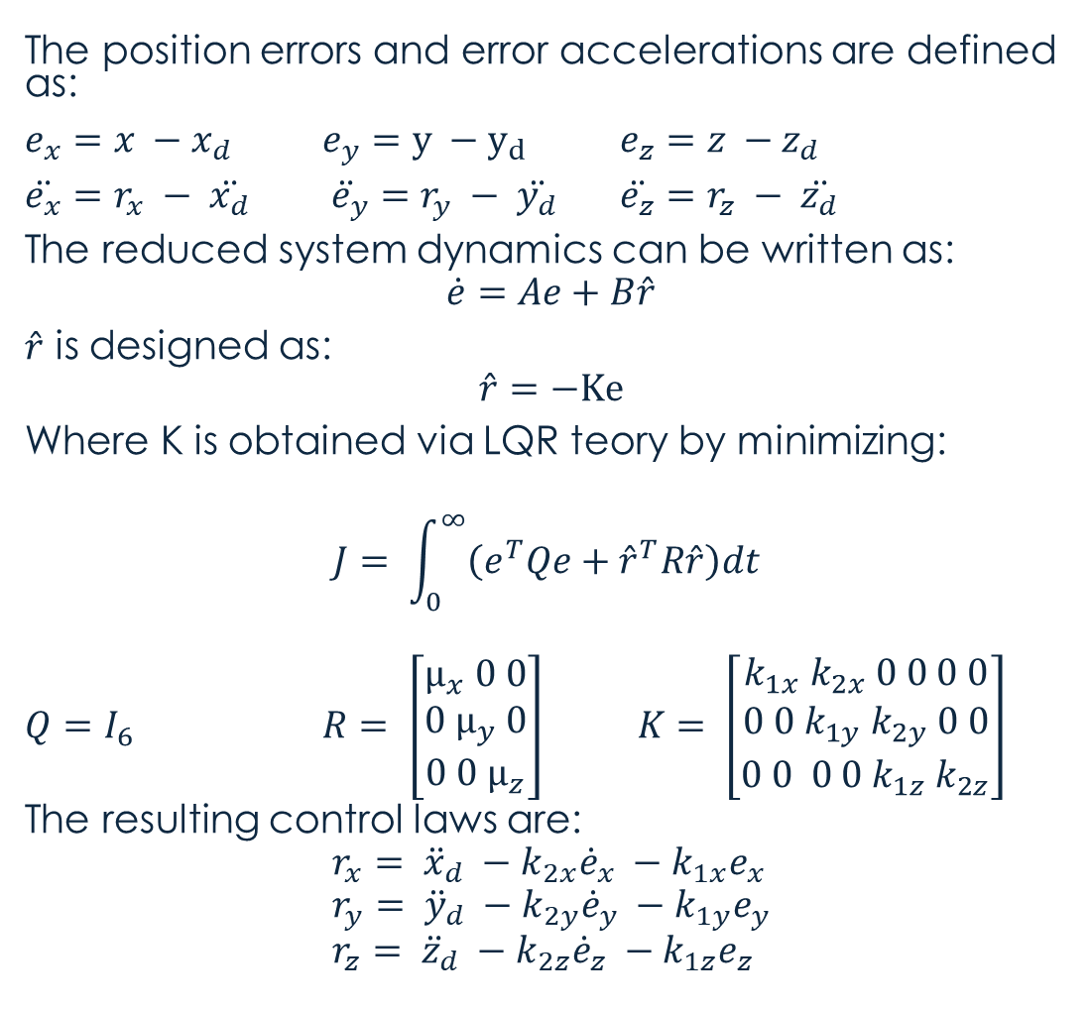
Posture Control
The position errors and error accelerations are defined as:
$e_{x}=x −x_{d}$ $e_{y}=y −y_{d}$ $e_{z}=z −z_{d}$
$\ddot{e_{x}}=r_{x} − \ddot{x_{d}}$ $\ddot{{ e}_{y}}=r_{y} − \ddot{y_{d}}$ $\ddot{e_{z}}=r_{z} − \ddot{z_{d}}$
The reduced system dynamics can be written as:
$$\dot{e}=Ae+B\hat{r}$$
$\hat{r}$ is designed as:
$$\hat{r}=−Ke$$
Where K is obtained via LQR teory by minimizing:
$$J= \int_{0}^{∞}{\left(e^{T}Qe+{\hat{r}}^{T}R\hat{r}\right)dt}$$
$Q=I_{6}$ $R= \left[\begin{aligned}μ_{x} 0 0 \\ 0 μ_{y} 0 \\ 0 0 μ_{z}\end{aligned}\right]$ $K= \left[\begin{aligned}k_{1x} k_{2x} 0 0 0 0 \\ 0 0{ k}_{1y}{ k}_{2y} 0 0 \\ 0 0 0 0{ k}_{1z}{ k}_{2z}\end{aligned}\right]$
The resulting control laws are:
$$r_{x}= {\ddot{x}}_{d} −k_{2x}{\dot{e}}_{x} −k_{1x}e_{x} \\ r_{y}= {\ddot{y}}_{d} −k_{2y}{\dot{e}}_{y} −k_{1y}e_{y} \\ r_{z}= {\ddot{z}}_{d} −k_{2z}{\dot{e}}_{z} −k_{1z}e_{z}$$
Trajectory Tracking for Quadrotors under External Wrenches: Hierarchical vs Passivity-Based Control

Slide 10
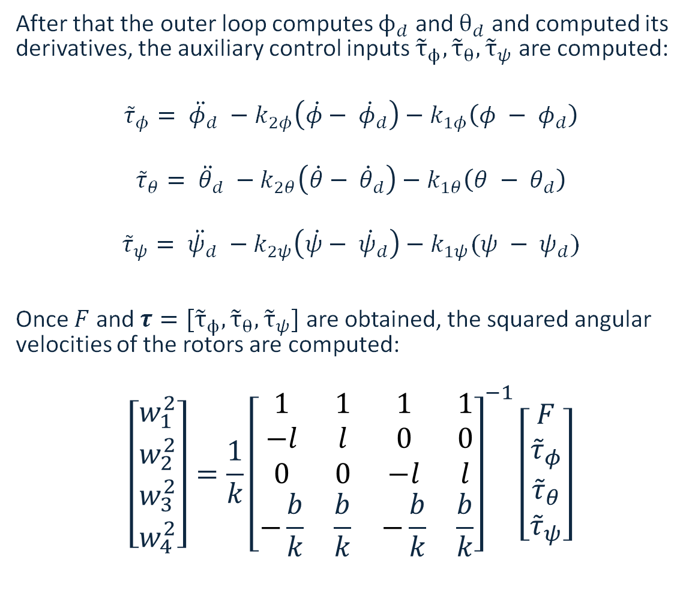
Orientation Control
After that the outer loop computes $ϕ_{d}$ and $θ_{d}$ and computed its derivatives, the auxiliary control inputs ${\tilde{τ}}_{ϕ},{\tilde{τ}}_{θ},{\tilde{τ}}_{ψ}$ are computed:
$${\tilde{τ}}_{φ}= {\ddot{φ}}_{d} −k_{2φ}\left(\dot{φ}− {\dot{φ}}_{d}\right)−k_{1φ}\left(φ − φ_{d}\right)$$
$${\tilde{τ}}_{θ}= {\ddot{θ}}_{d} −k_{2θ}\left(\dot{θ}− {\dot{θ}}_{d}\right)−k_{1θ}\left(θ − θ_{d}\right)$$
$${\tilde{τ}}_{ψ}= {\ddot{ψ}}_{d} −k_{2ψ}\left(\dot{ψ}− {\dot{ψ}}_{d}\right)−k_{1ψ}(ψ − ψ_{d})$$
Once $F$ and $τ=[{\tilde{τ}}_{ϕ},{\tilde{τ}}_{θ},{\tilde{τ}}_{ψ}]$ are obtained, the squared angular velocities of the rotors are computed:
$$\left[\begin{aligned}w_{1}^{2} \\ w_{2}^{2} \\ w_{3}^{2} \\ w_{4}^{2}\end{aligned}\right]=\frac{1}{k}{\left[\begin{matrix}1 & 1 & 1 & 1 \\ −l & l & 0 & 0 \\ 0 & 0 & −l & l \\ −\frac{b}{k} & \frac{b}{k} & −\frac{b}{k} & \frac{b}{k}\end{matrix}\right]}^{−1}\left[\begin{aligned}F \\ {\tilde{τ}}_{φ} \\ {\tilde{τ}}_{θ} \\ {\tilde{τ}}_{ψ}\end{aligned}\right]$$
Trajectory Tracking for Quadrotors under External Wrenches: Hierarchical vs Passivity-Based Control

Slide 11
Passivity-Based Control
Trajectory Tracking for Quadrotors under External Wrenches: Hierarchical vs Passivity-Based Control

Slide 12
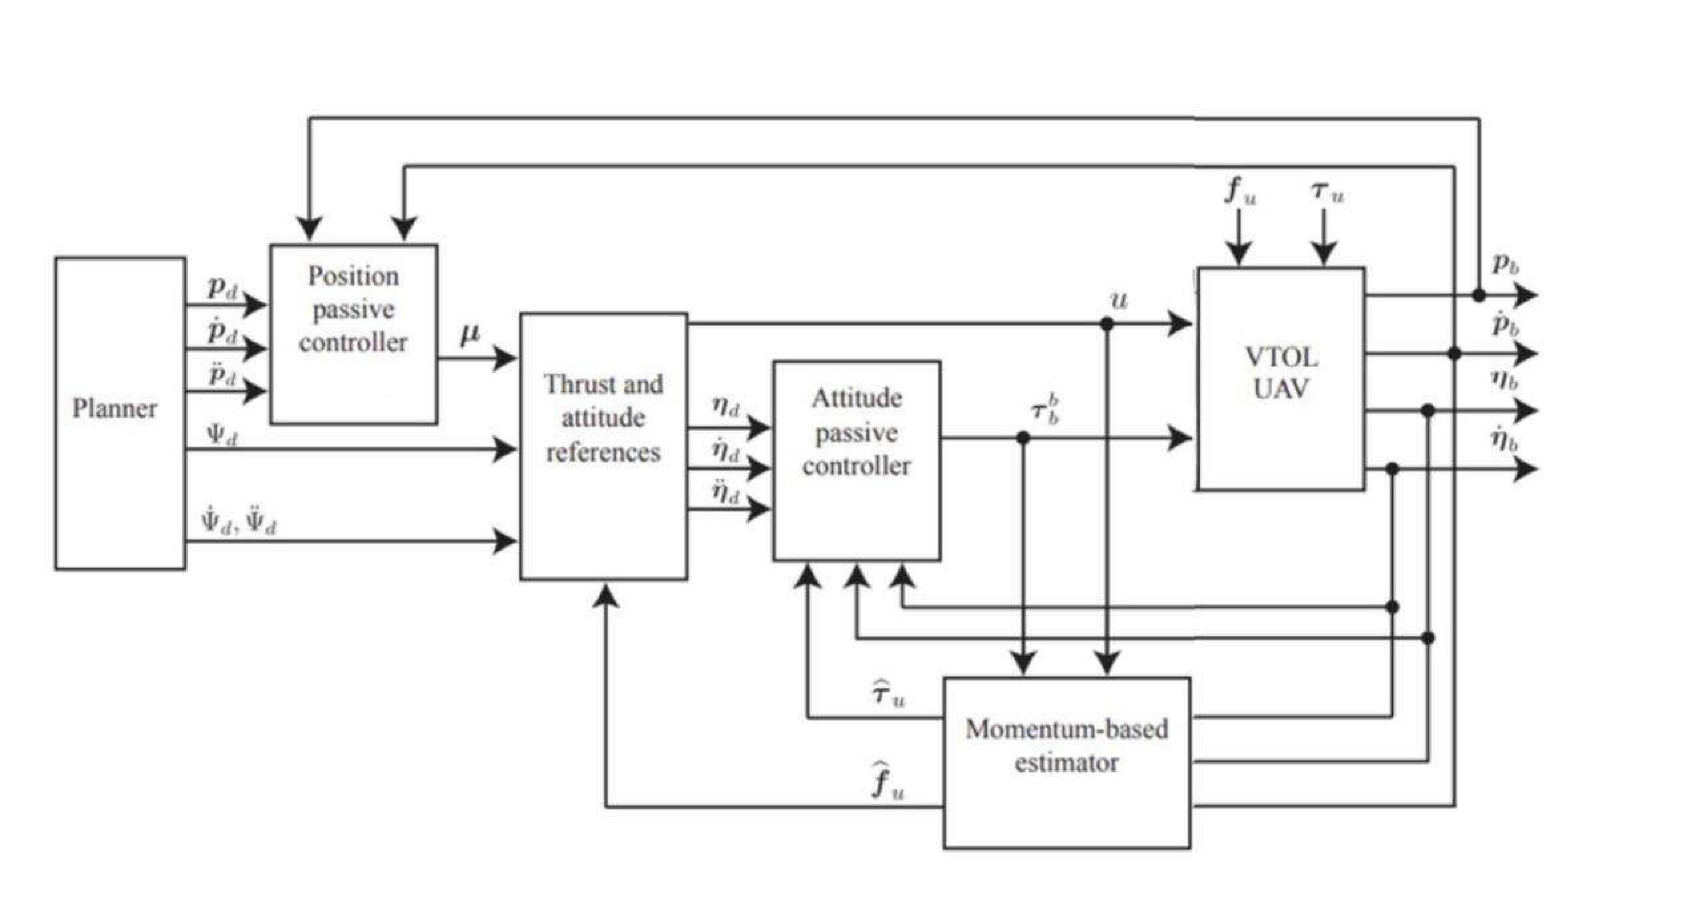
Block diagram
Trajectory Tracking for Quadrotors under External Wrenches: Hierarchical vs Passivity-Based Control

Slide 13
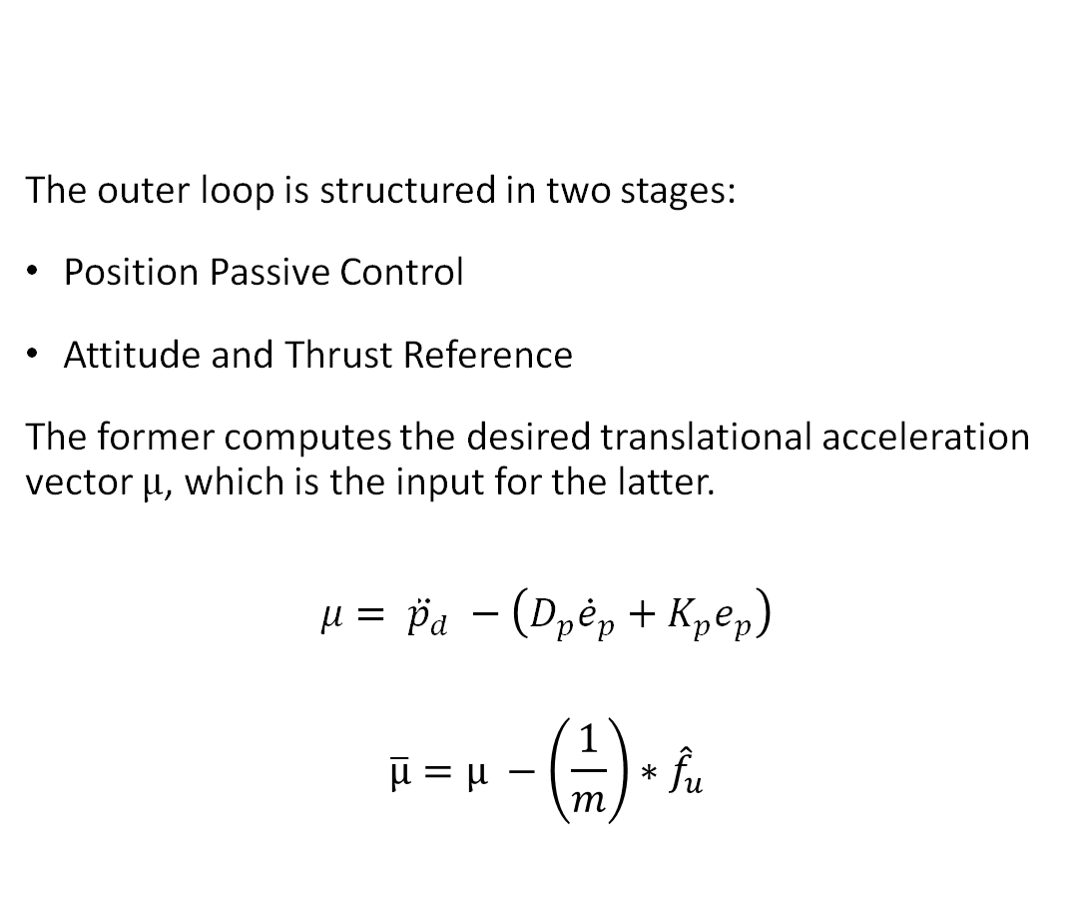
Outer Loop
The outer loop is structured in two stages:
Position Passive Control
Attitude and Thrust Reference
The former computes the desired translational acceleration vector $μ$, which is the input for the latter.
$$μ= {\ddot{p}}_{d} −\left(D_{p}{\dot{e}}_{p}+K_{p}e_{p}\right)$$ $$\overline{μ}=μ −\left(\frac{1}{m}\right)∗{\hat{f}}_{u}$$
Trajectory Tracking for Quadrotors under External Wrenches: Hierarchical vs Passivity-Based Control

Slide 14
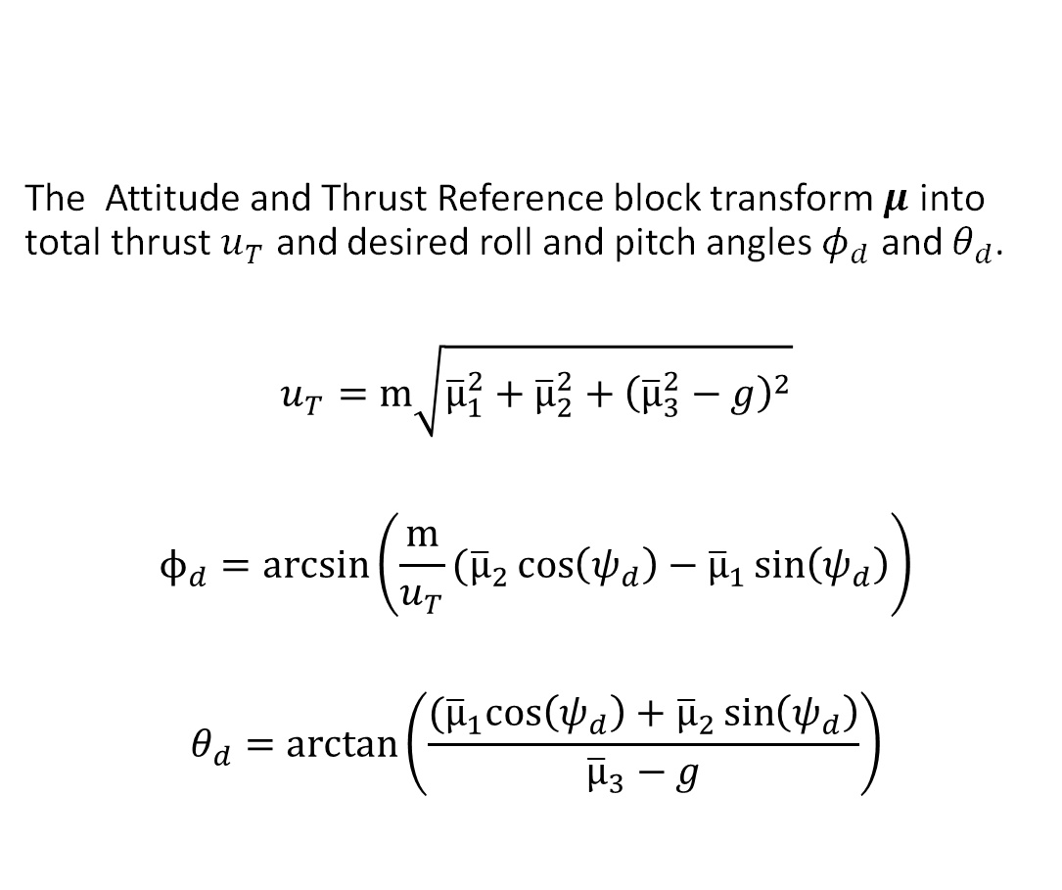
Outer Loop
The Attitude and Thrust Reference block transform $μ$ into total thrust $u_{T}$ and desired roll and pitch angles $φ_{d}$ and $θ_{d}$.
$$u_{T}=m\sqrt{{\overline{μ}}_{1}^{2}+{\overline{μ}}_{2}^{2}+{\left({\overline{μ}}_{3}^{2}−g\right)}^{2}}$$
$$ϕ_{d}=arcsin\left(\frac{m}{u_{T}}({\overline{μ}}_{2}\cos\left(ψ_{d}\right)−{\overline{μ}}_{1}\sin\left(ψ_{d}\right)\right)$$
$$θ_{d}=arctan\left(\frac{{(\overline{μ}}_{1}\cos\left(ψ_{d}\right)+{\overline{μ}}_{2}\sin\left(ψ_{d}\right)}{{\overline{μ}}_{3}−g}\right)$$
Trajectory Tracking for Quadrotors under External Wrenches: Hierarchical vs Passivity-Based Control

Slide 15

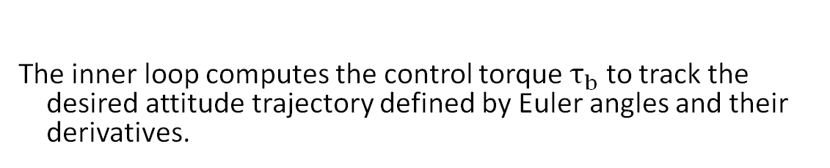


Inner Loop
The inner loop computes the control torque $τ_{b}$ to track the desired attitude trajectory defined by Euler angles and their derivatives.
$τ_{b}=Q{\left(η\right)}^{−T}(M\left(η\right){\ddot{η}}_{r}+C\left(η,\dot{η}\right){\dot{η}}_{r} −D_{o}v_{η} −K_{o}e_{η} − {\hat{τ}}_{u}$)
where the errors are:
$$e_{η}=η −η_{d}$$
Attitude error
$${\dot{e}}_{η}= \dot{η} −{\dot{η}}_{d}$$
Angular velocity error
$v_{η}= {\dot{e}}_{η}+ νe_{η}$
Velocity error
Trajectory Tracking for Quadrotors under External Wrenches: Hierarchical vs Passivity-Based Control

Slide 16
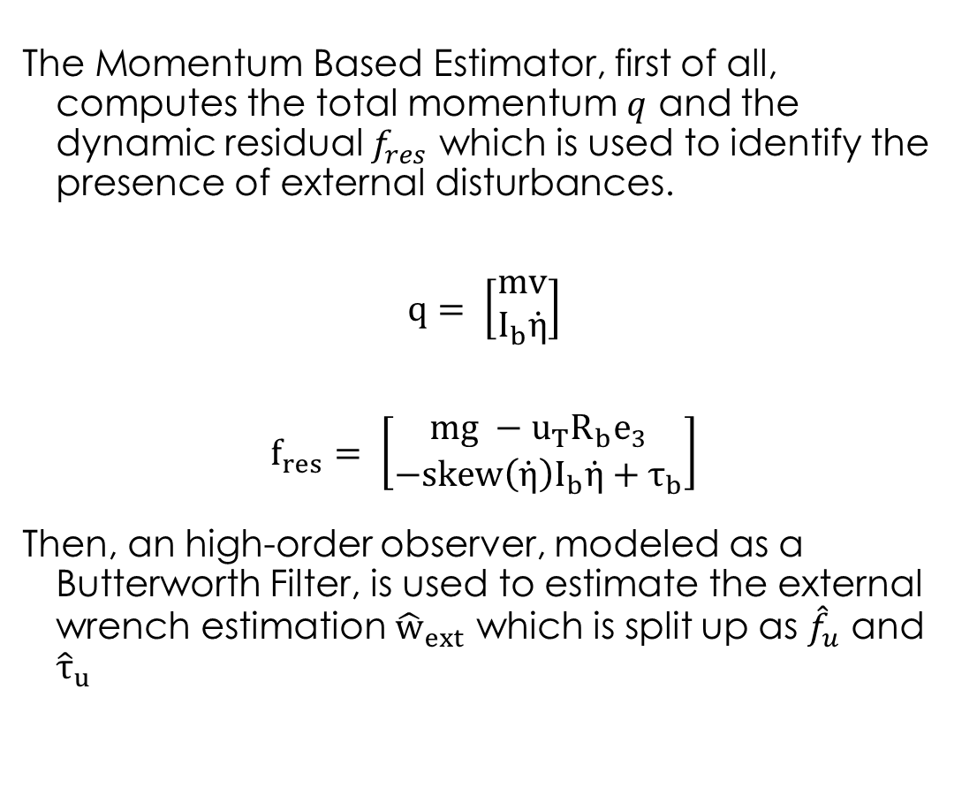
Momentum Based Estimator
The Momentum Based Estimator, first of all, computes the total momentum $q$ and the dynamic residual $f_{res}$ which is used to identify the presence of external disturbances.
$$q= \left[\begin{aligned}mv \\ I_{b}\dot{η}\end{aligned}\right]$$
$$f_{res}= \left[\begin{aligned}mg −u_{T}R_{b}e_{3} \\ −skew\left(\dot{η}\right)I_{b}\dot{η}+τ_{b}\end{aligned}\right]$$
Then, an high-order observer, modeled as a Butterworth Filter, is used to estimate the external wrench estimation ${\hat{w}}_{ext}$ which is split up as ${\hat{f}}_{u}$ and ${\hat{τ}}_{u}$
Trajectory Tracking for Quadrotors under External Wrenches: Hierarchical vs Passivity-Based Control

Slide 17
Experiments and Results
Trajectory Tracking for Quadrotors under External Wrenches: Hierarchical vs Passivity-Based Control

Slide 18
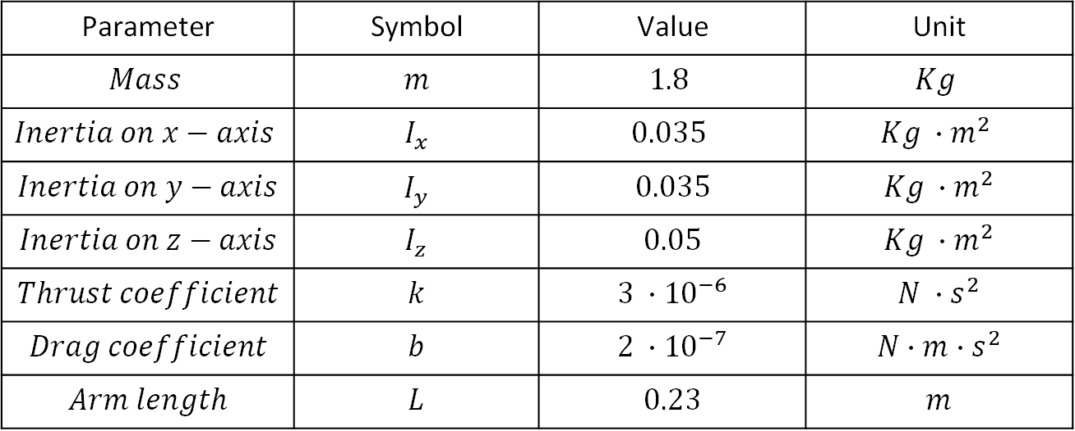
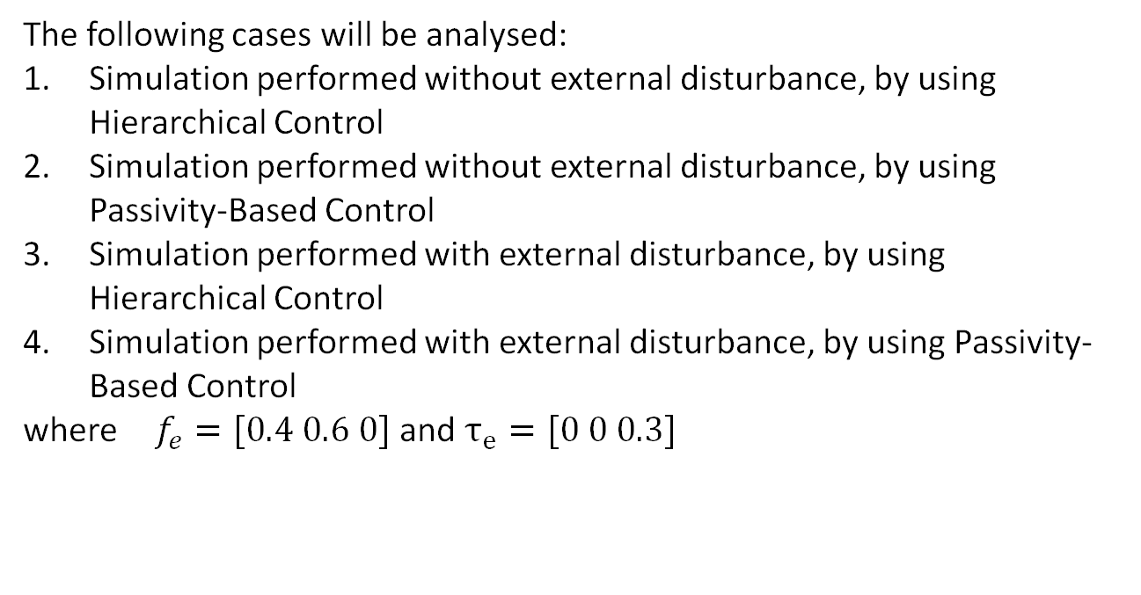
Parameters and case of study
$$\text{Parameter}$$ | $$\text{Symbol}$$ | $$\text{Value}$$ | $$\text{Unit}$$
$$Mass$$ | $$m$$ | $$1.8$$ | $$Kg$$
$$Inertia on x−axis$$ | $$I_{x}$$ | $$0.035$$ | $$Kg ∙m^{2}$$
$$Inertia on y−axis$$ | $$I_{y}$$ | $$0.035$$ | $$Kg ∙m^{2}$$
$$Inertia on z−axis$$ | $$I_{z}$$ | $$0.05$$ | $$Kg ∙m^{2}$$
$$Thrust coefficient$$ | $$k$$ | $$3 ∙{10}^{−6}$$ | $$N ∙s^{2}$$
$$Drag coefficient$$ | $$b$$ | $$2 ∙{10}^{−7}$$ | $$N∙m∙s^{2}$$
$$Arm length$$ | $$L$$ | $$0.23$$ | $$m$$
The following cases will be analysed:
Simulation performed without external disturbance, by using Hierarchical Control
Simulation performed without external disturbance, by using Passivity-Based Control
Simulation performed with external disturbance, by using Hierarchical Control
Simulation performed with external disturbance, by using Passivity-Based Control
where $f_{e}=[0.4 0.6 0]$ and $τ_{e}=[0 0 0.3]$
Trajectory Tracking for Quadrotors under External Wrenches: Hierarchical vs Passivity-Based Control

Slide 19
Without Disturbance
Trajectory Tracking for Quadrotors under External Wrenches: Hierarchical vs Passivity-Based Control

Slide 20
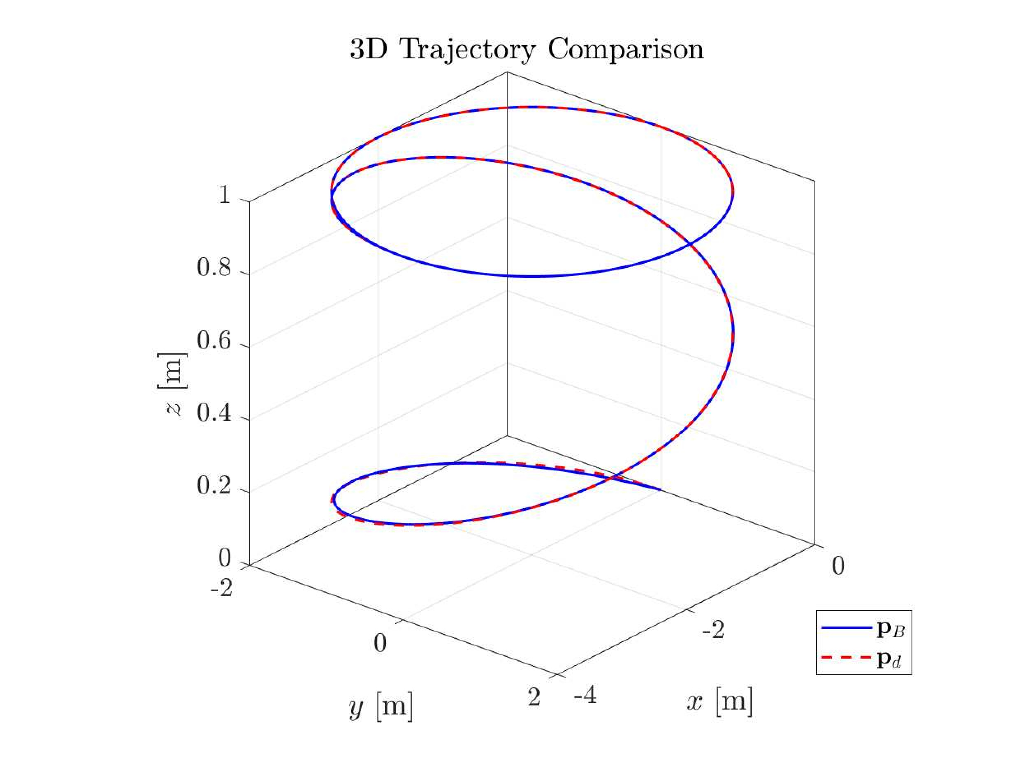
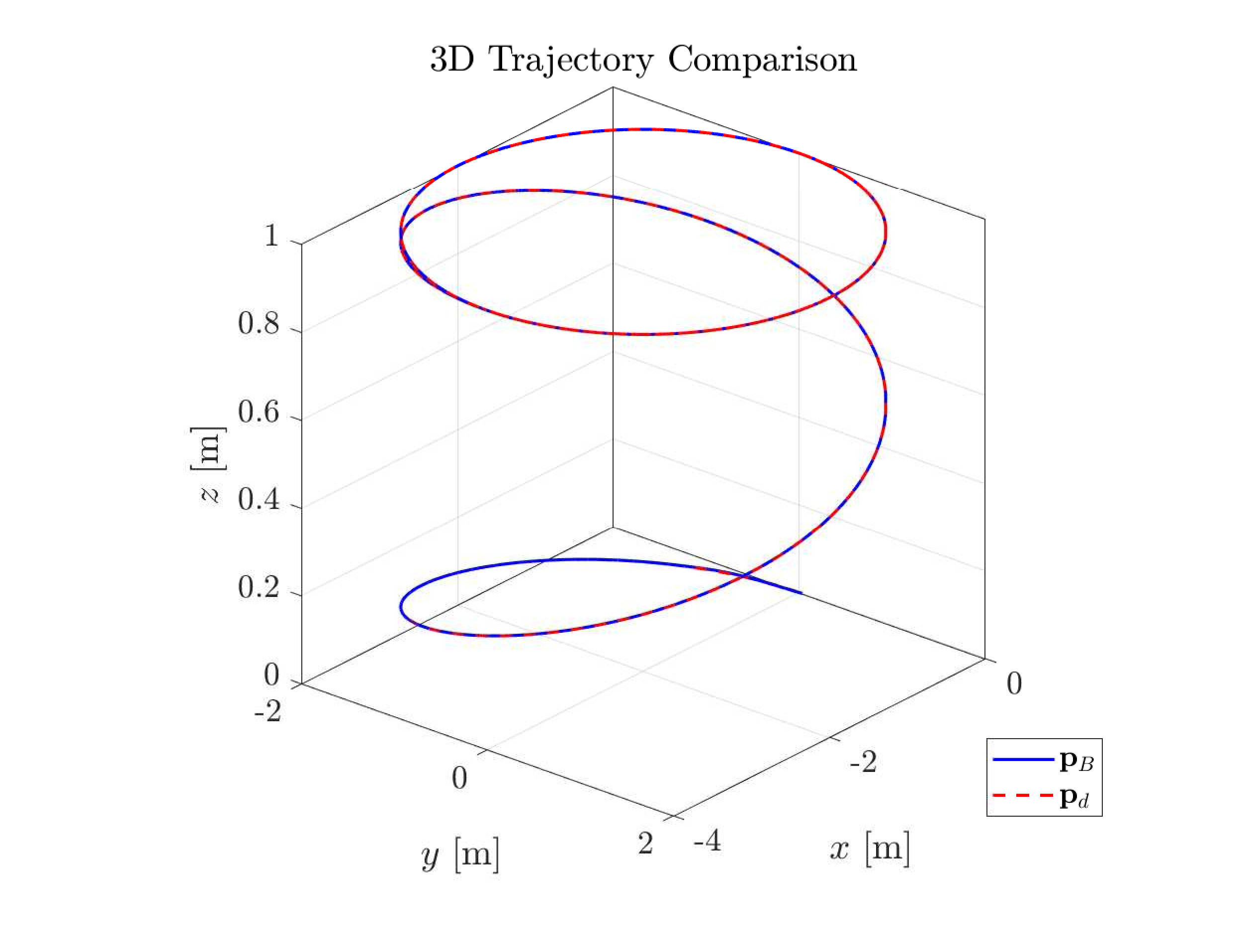
Tracking Performance
Hierarchical Control
Passivity-Based Control
Trajectory Tracking for Quadrotors under External Wrenches: Hierarchical vs Passivity-Based Control

Slide 21
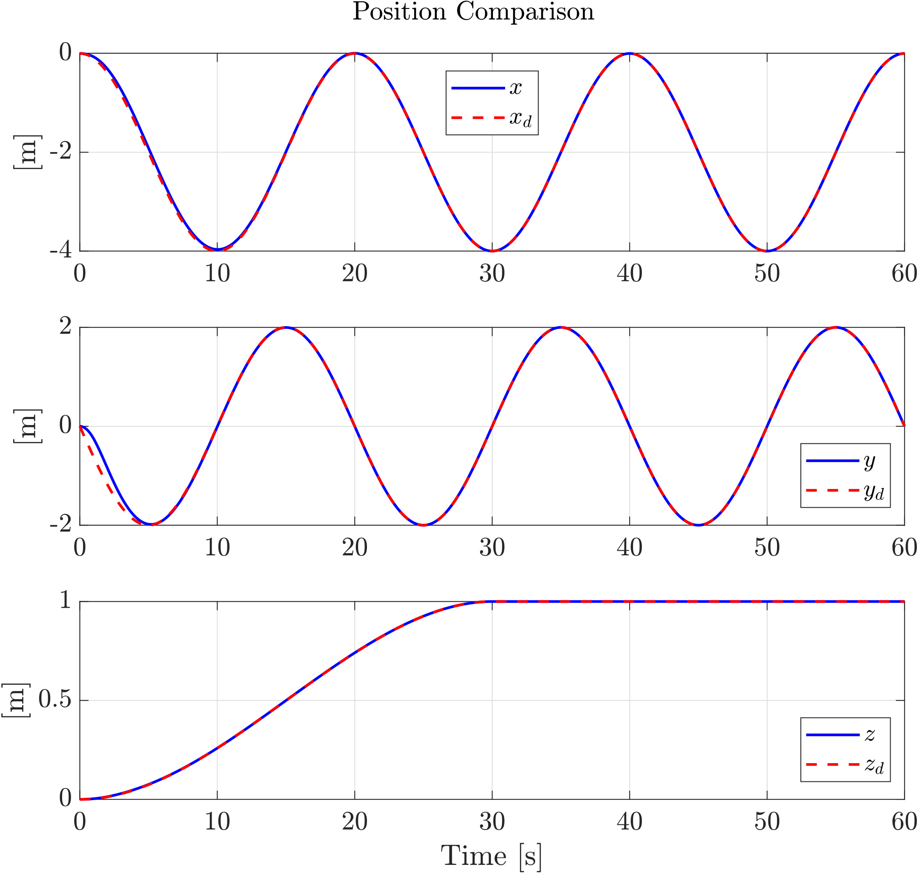
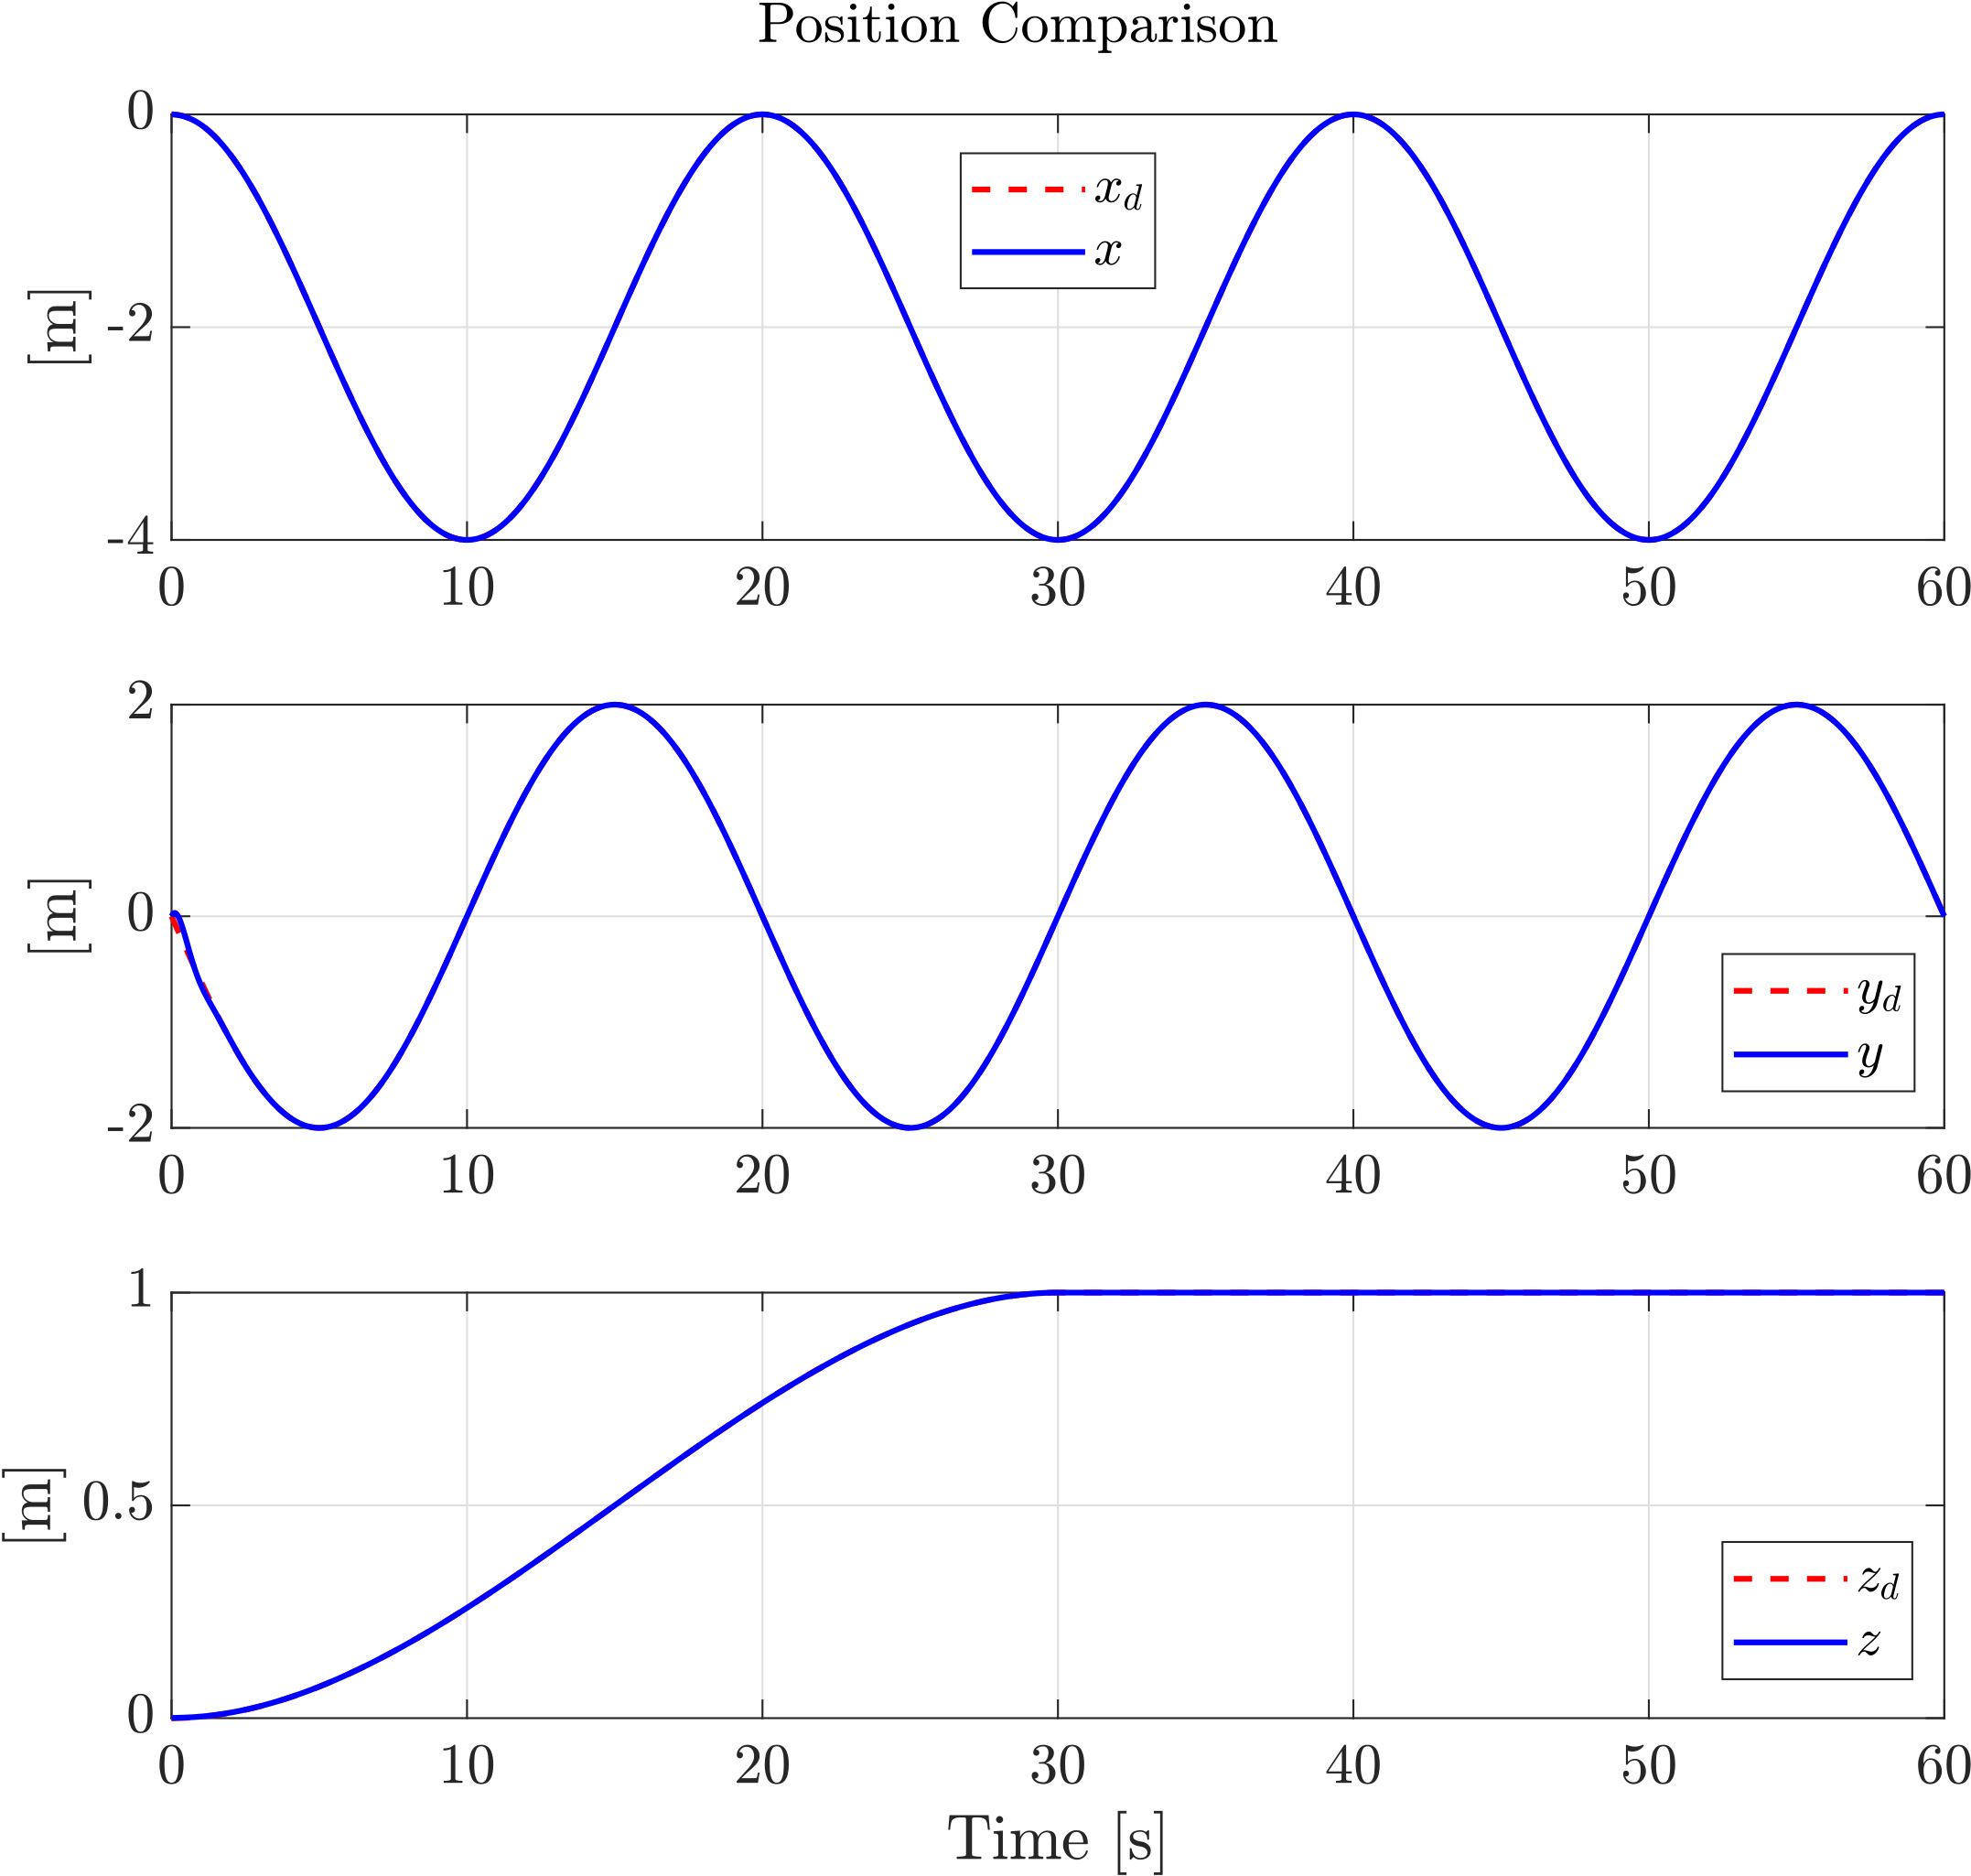
Position Tracking
Hierarchical Control
Passivity-Based Control
Trajectory Tracking for Quadrotors under External Wrenches: Hierarchical vs Passivity-Based Control

Slide 22
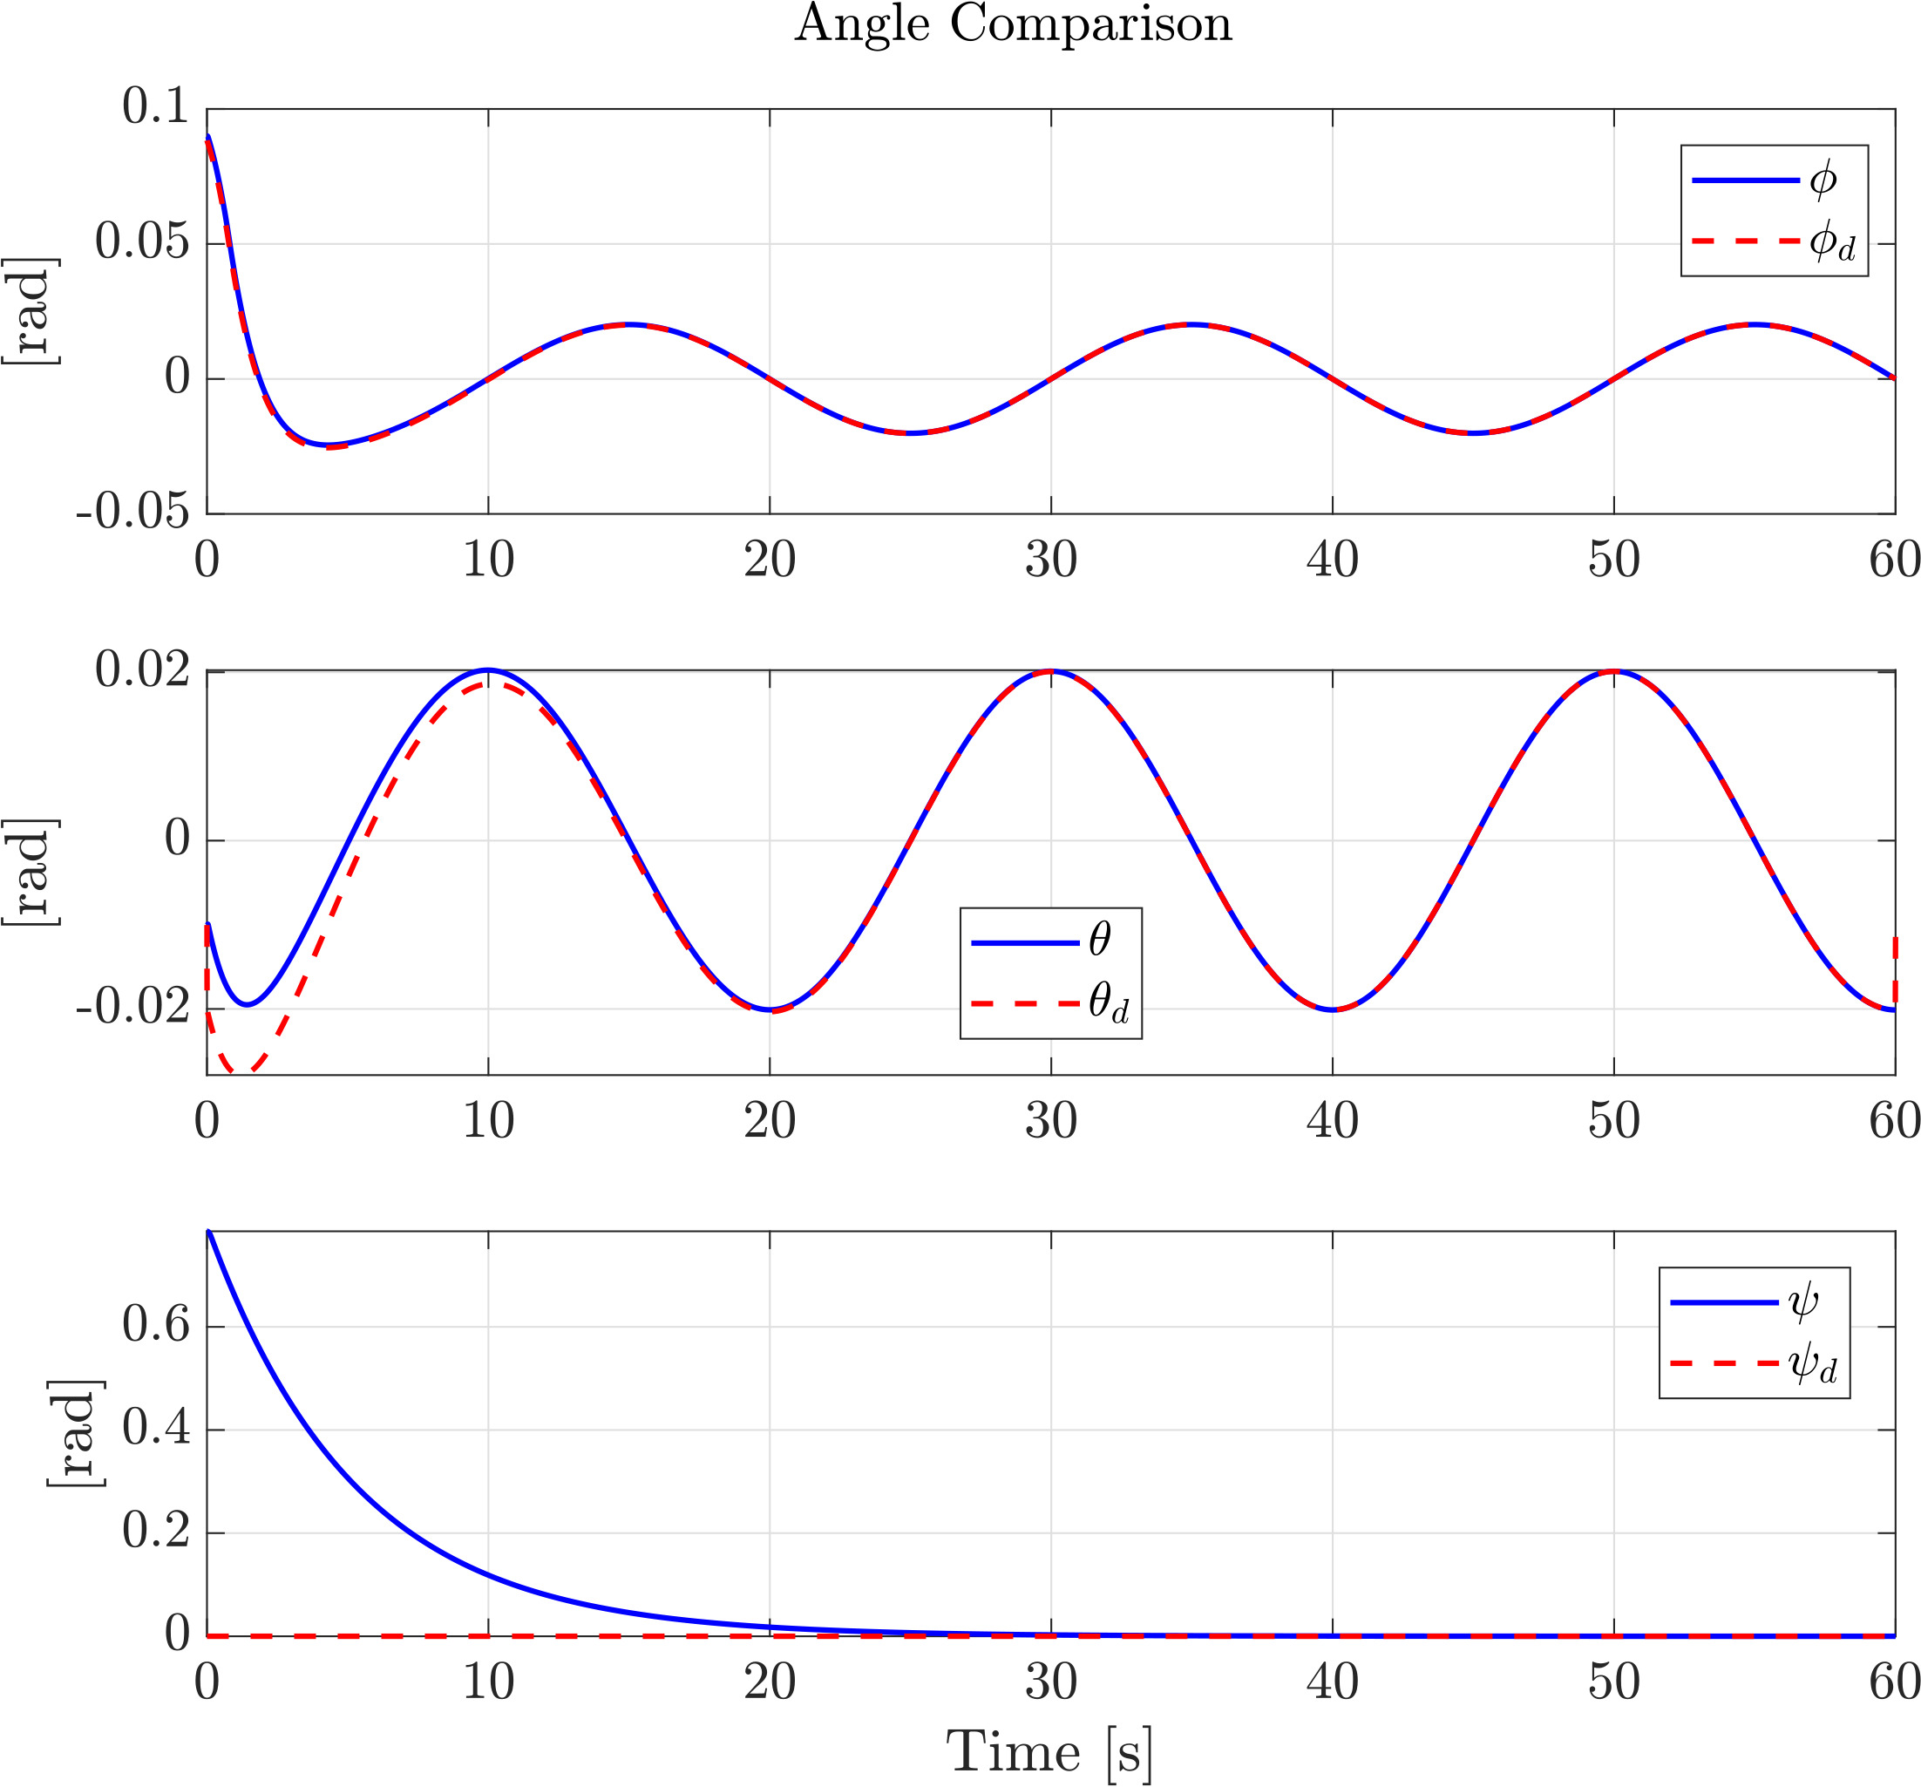
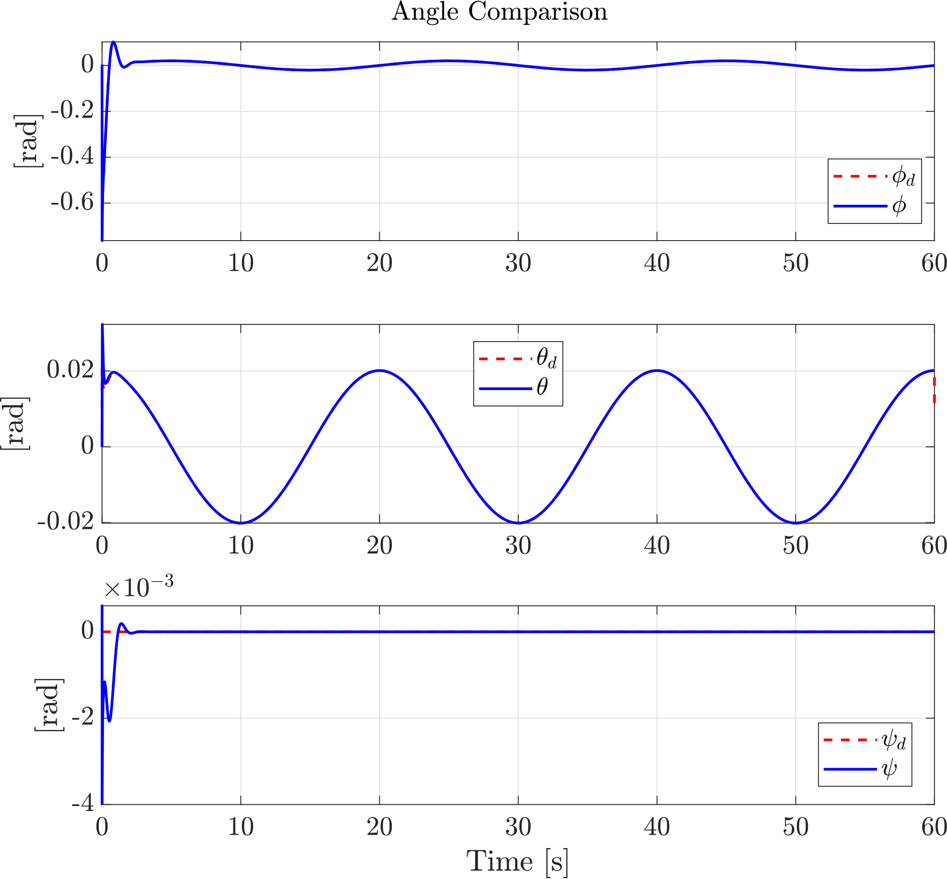
Orientation Tracking
Hierarchical Control
Passivity-Based Control
Trajectory Tracking for Quadrotors under External Wrenches: Hierarchical vs Passivity-Based Control

Slide 23
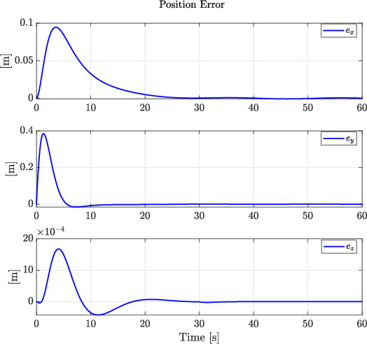
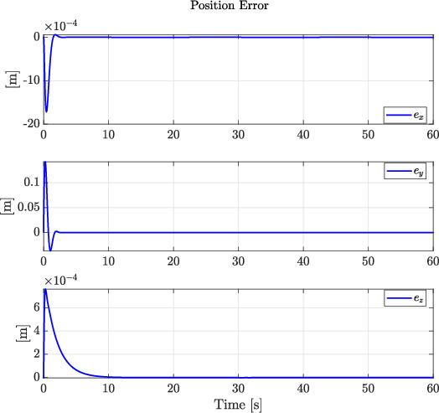
Position Error
Hierarchical Control
Passivity-Based Control
Trajectory Tracking for Quadrotors under External Wrenches: Hierarchical vs Passivity-Based Control

Slide 24
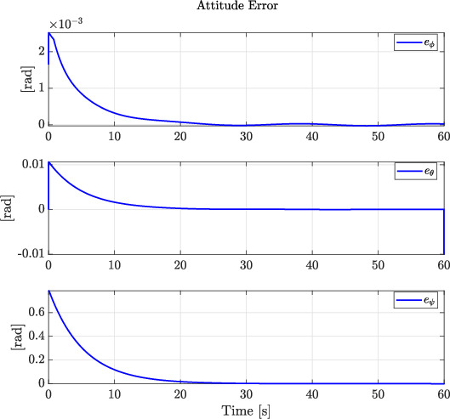
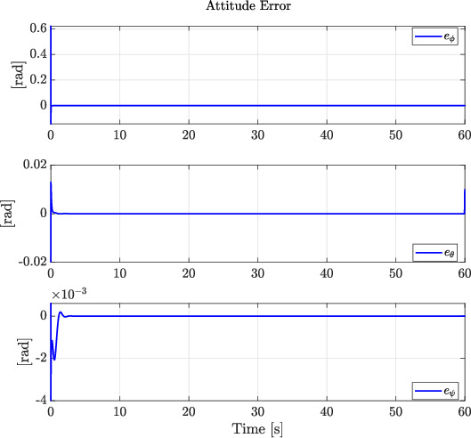
Attitude Error
Hierarchical Control
Passivity-Based Control
Trajectory Tracking for Quadrotors under External Wrenches: Hierarchical vs Passivity-Based Control

Slide 25
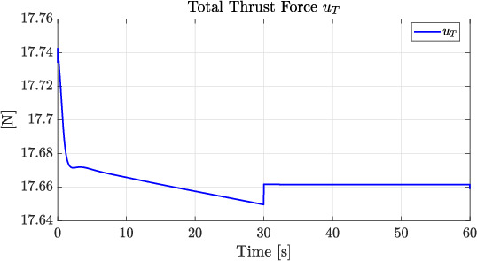
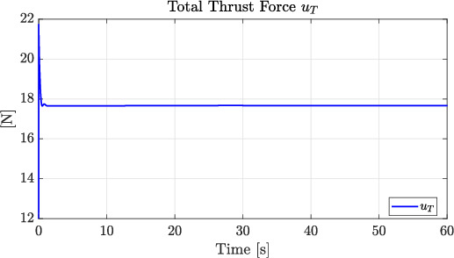
Total Thrust
Hierarchical Control
Passivity-Based Control
Trajectory Tracking for Quadrotors under External Wrenches: Hierarchical vs Passivity-Based Control

Slide 26
With Disturbance
Trajectory Tracking for Quadrotors under External Wrenches: Hierarchical vs Passivity-Based Control

Slide 27
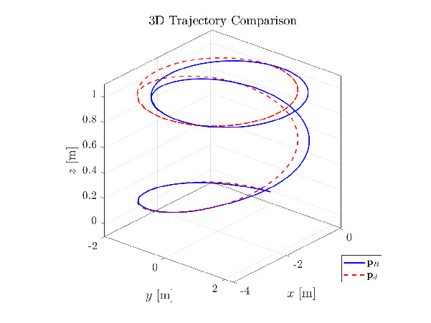
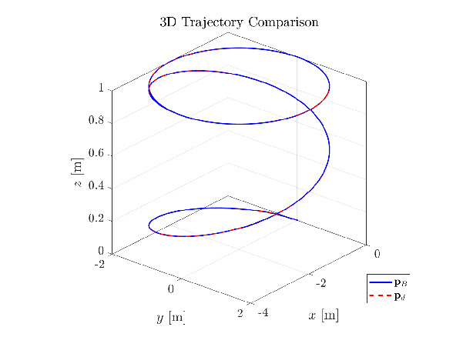
Tracking Performance
Hierarchical Control
Passivity-Based Control
Trajectory Tracking for Quadrotors under External Wrenches: Hierarchical vs Passivity-Based Control

Slide 28
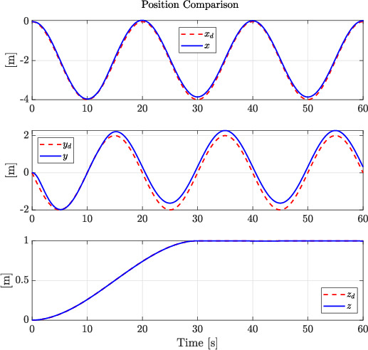
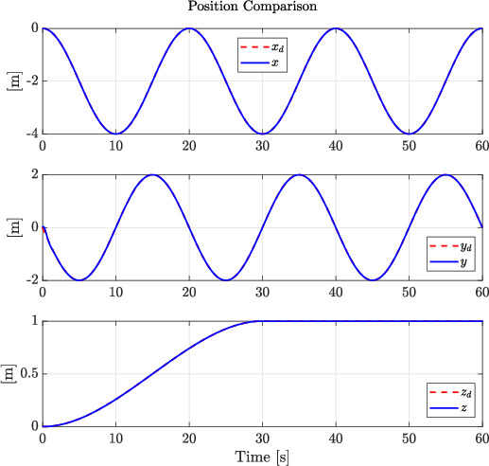
Position Tracking
Hierarchical Control
Passivity-Based Control
Trajectory Tracking for Quadrotors under External Wrenches: Hierarchical vs Passivity-Based Control

Slide 29
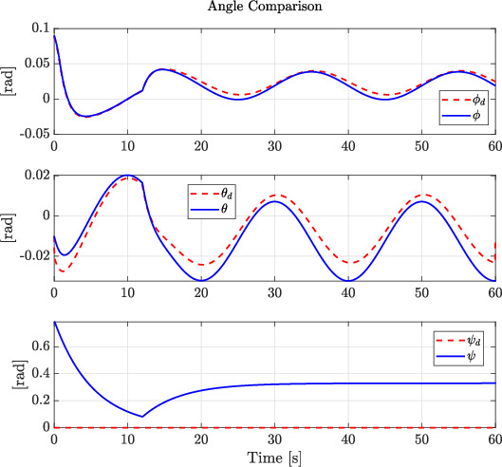
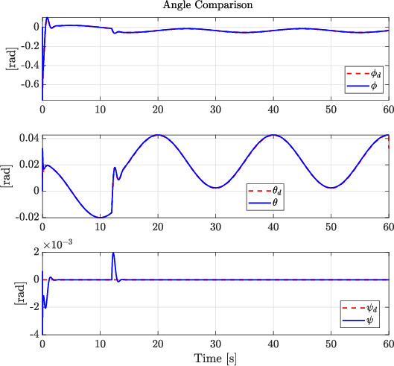
Orientation Tracking
Hierarchical Control
Passivity-Based Control
Trajectory Tracking for Quadrotors under External Wrenches: Hierarchical vs Passivity-Based Control

Slide 30
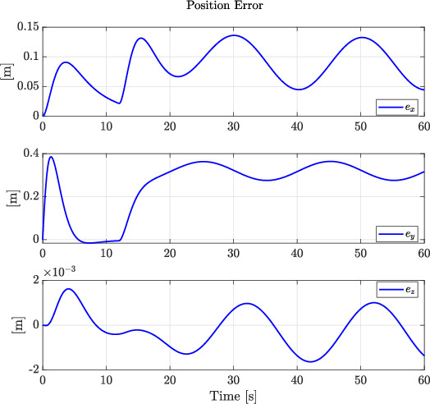
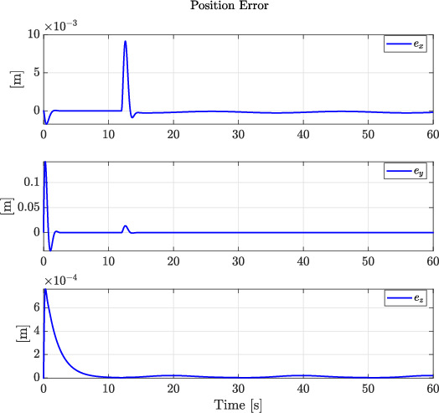
Position Error
Hierarchical Control
Passivity-Based Control
Trajectory Tracking for Quadrotors under External Wrenches: Hierarchical vs Passivity-Based Control

Slide 31
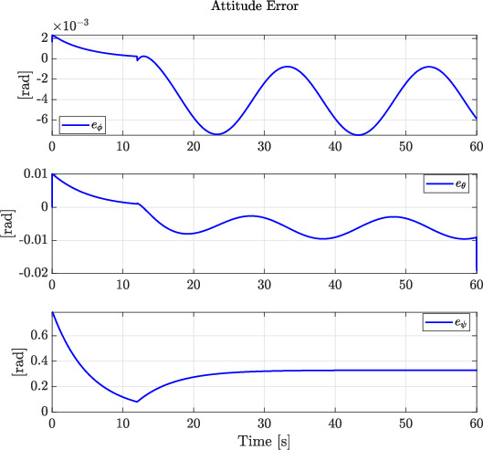
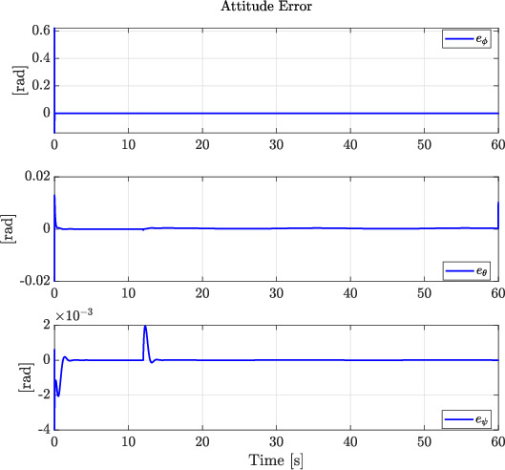
Attitude Error
Hierarchical Control
Passivity-Based Control
Trajectory Tracking for Quadrotors under External Wrenches: Hierarchical vs Passivity-Based Control

Slide 32
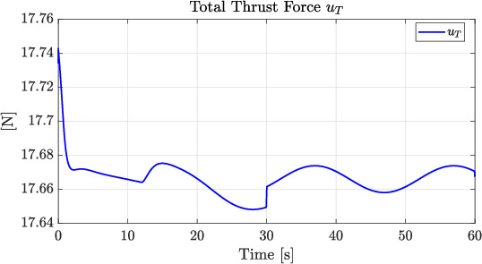
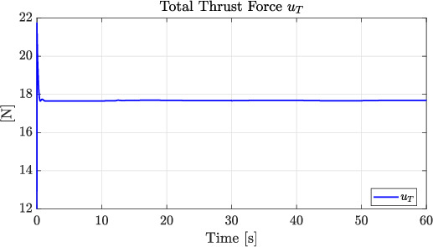
Total Thrust
Hierarchical Control
Passivity-Based Control
Trajectory Tracking for Quadrotors under External Wrenches: Hierarchical vs Passivity-Based Control

Slide 33
Critical and final discussion
Hierarchical Control
Optimal for energy-efficient tracking
Performs best in disturbance-free environments
Passivity-based Control
Robust to external disturbances
Ensures tracking despite uncertainties
Higher control effort required
Trajectory Tracking for Quadrotors under External Wrenches: Hierarchical vs Passivity-Based Control

Slide 34
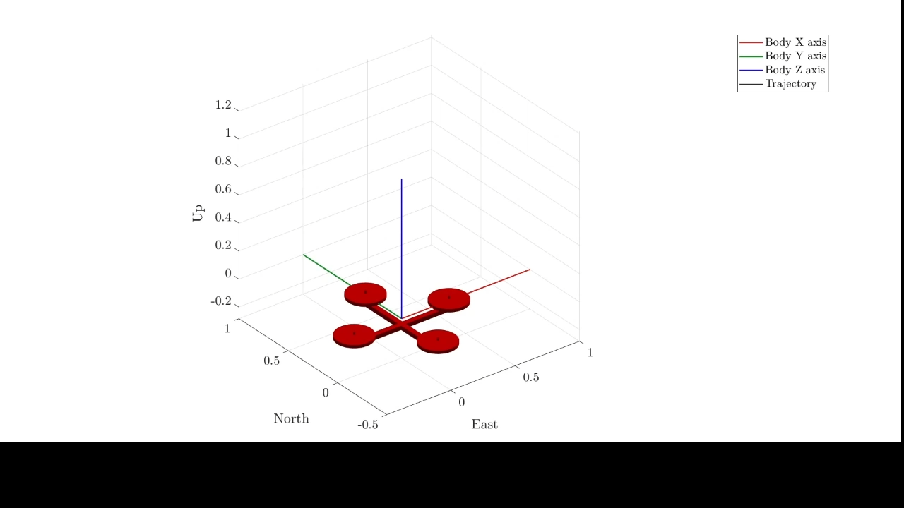
Hierarchical no disturbance
Trajectory Tracking for Quadrotors under External Wrenches: Hierarchical vs Passivity-Based Control

Slide 35
THANKS FOR YOUR ATTENTION
Trajectory Tracking for Quadrotors under External Wrenches: Hierarchical vs Passivity-Based Control

